Slide 1

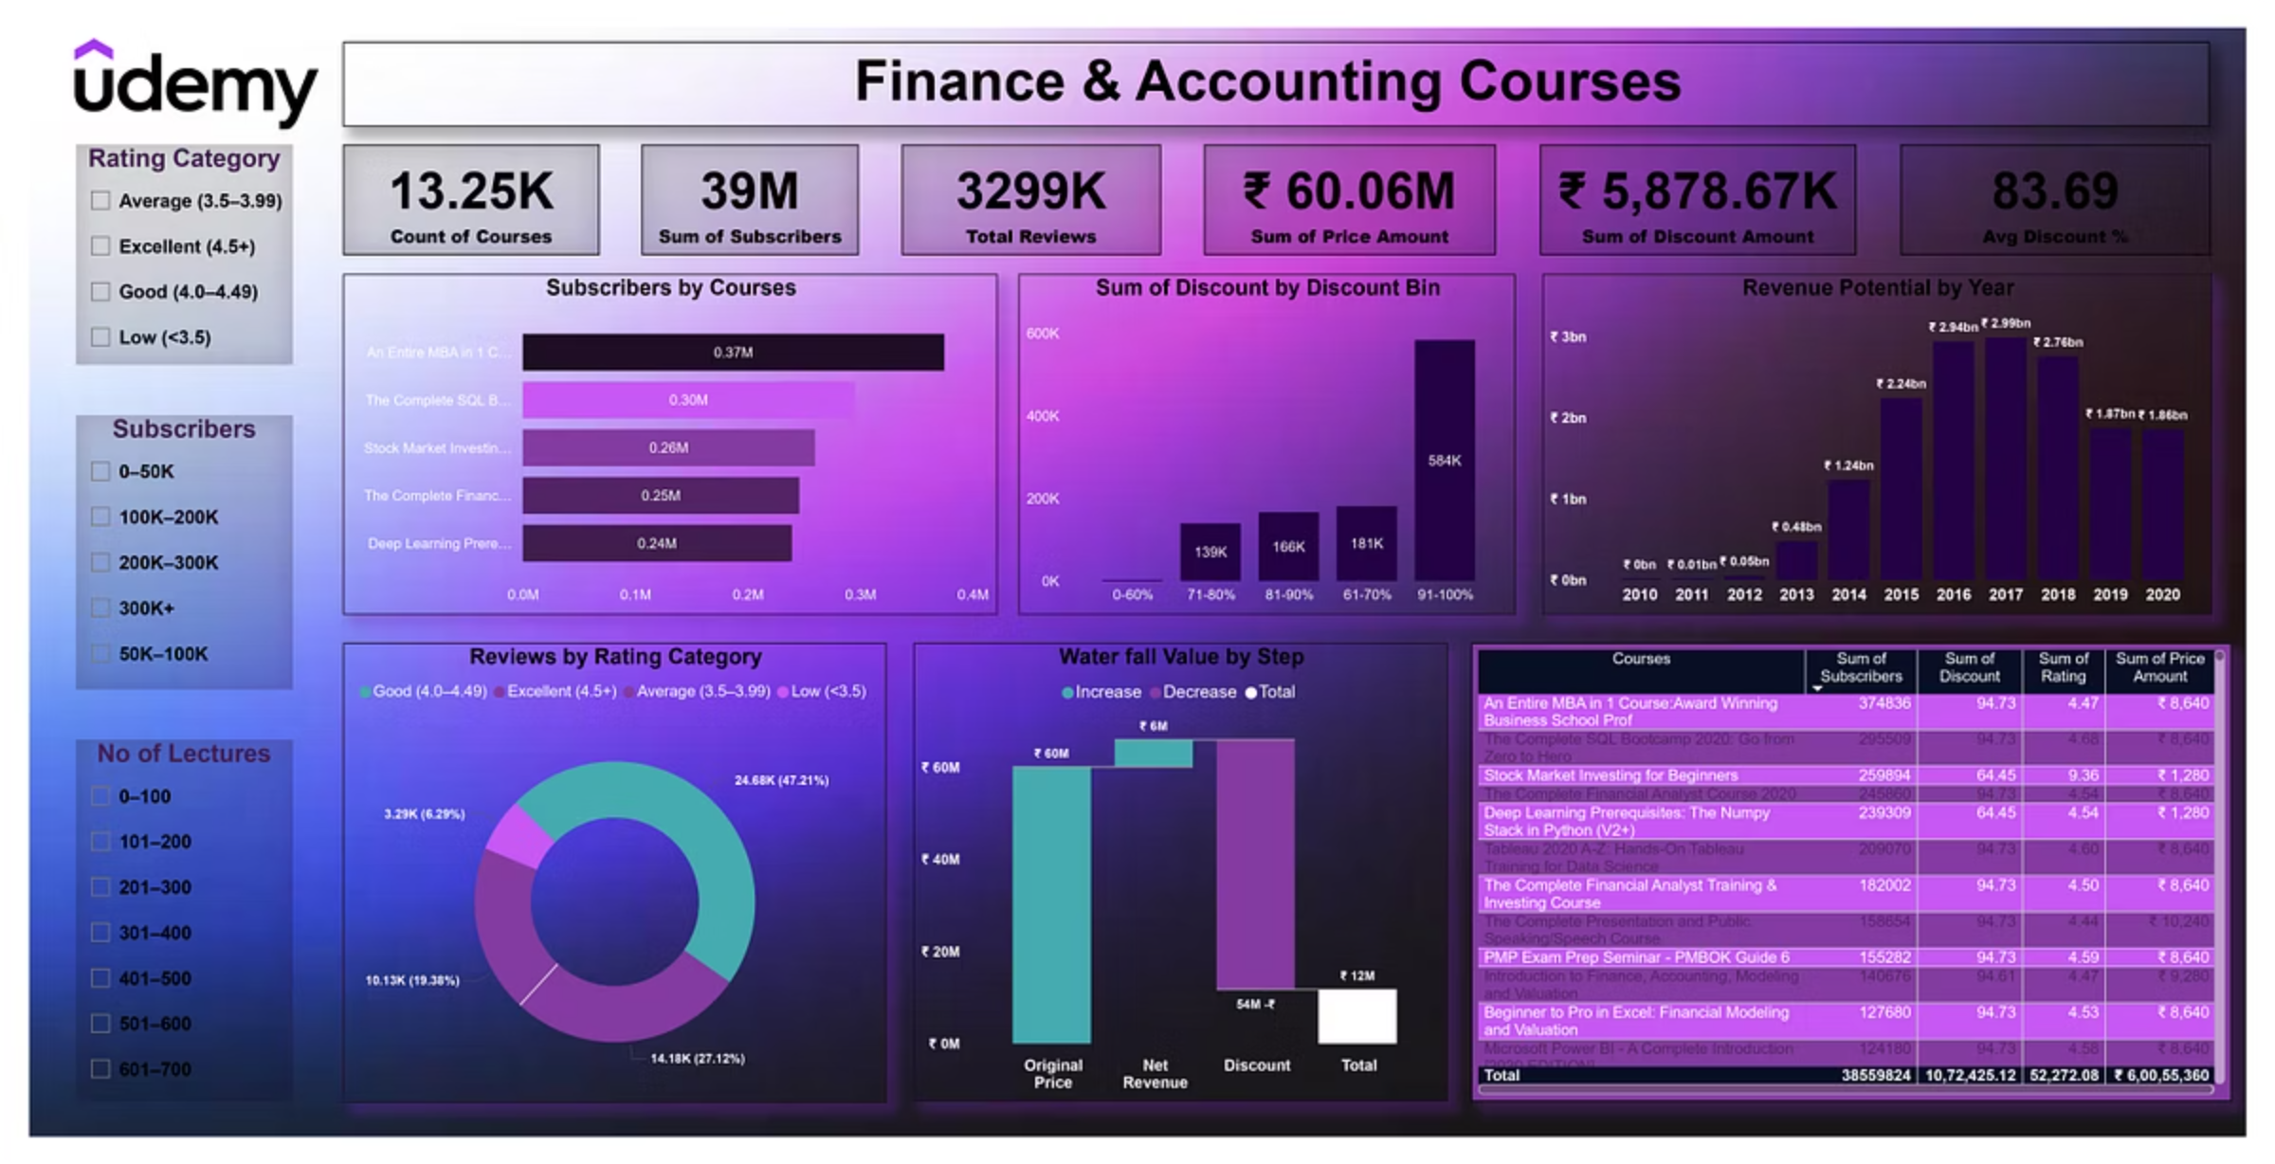
Overview – Finance & Accounting Courses (Udemy)
📘 About Dataset This project focuses on 13K+ development-related courses available on Udemy under the Finance & Accounting domain. It includes courses from areas like Bookkeeping, Compliance, Cryptocurrency, Blockchain, Economics, Investing & Trading, Taxes, and more.
📦 Context This dataset is a curated subset of ~10K courses under the Development category from Udemy's public listings, focusing on pricing, ratings, lectures, and user interactions.

Slide 2
KPIs (All in ₹ INR)
13.25K
39M
3,299K
Total Courses
Total Subscribers
Total Reviews
₹60.06M
₹5,878.67K
83.69%
Total Price Value
Total Discount Amount
Average Discount %

Slide 3
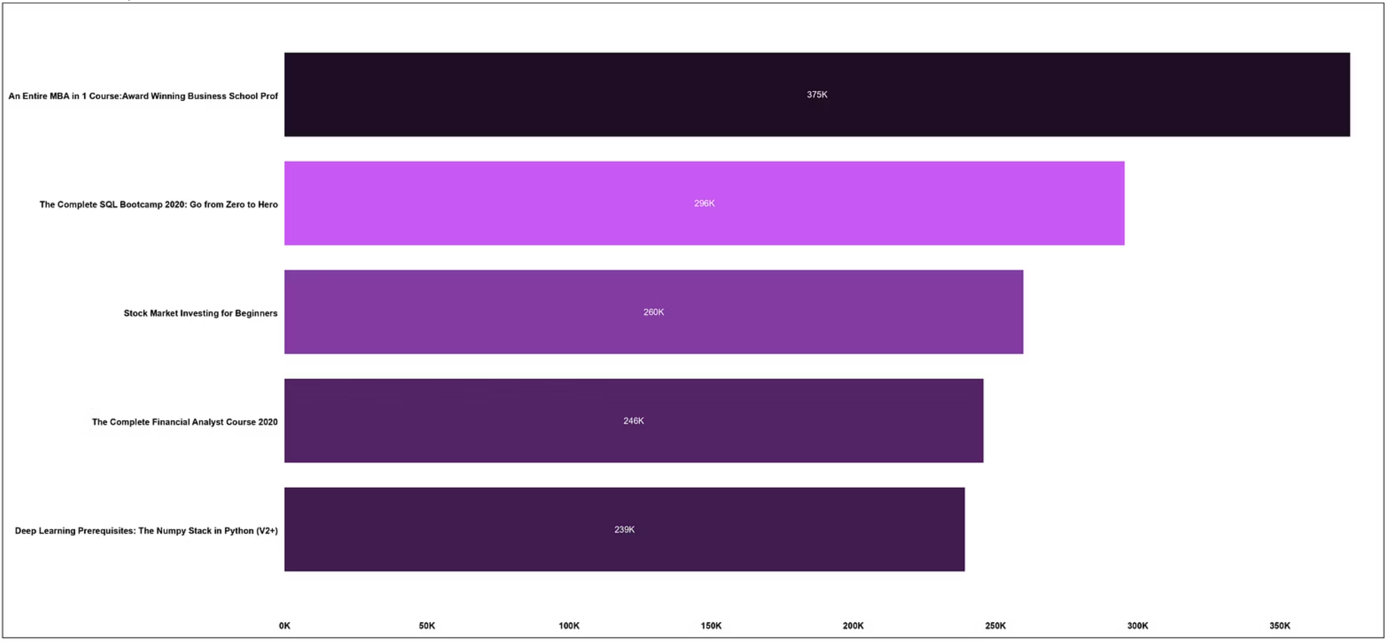
Top Course Subscribers – Stacked Bar Chart
"An Entire MBA in 1 Course" had the highest subscribers at 374,836, which is 56.63% higher than the lowest, “Deep Learning Prerequisites”, with 239,309.
This course alone contributed to 26.48% of total subscribers.
📊 Revenue potential showed a sharp upward trend from 2010 to 2020, rising by 174,697.61%.

Slide 4
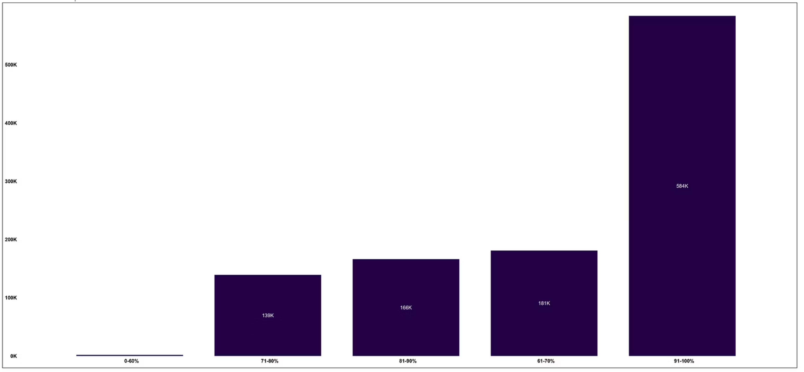
Discount Bin Distribution – Stacked Column Chart
Highest discount frequency lies in the 91–100% range.

Slide 5
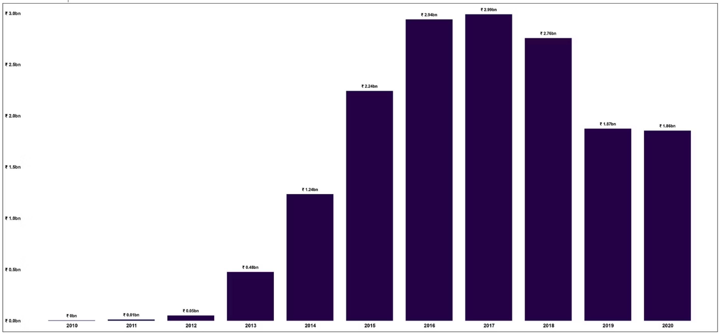
Revenue Potential by Year – Clustered Column Chart
📈 Growth was exponential over the decade, peaking in 2018–2019.

Slide 6
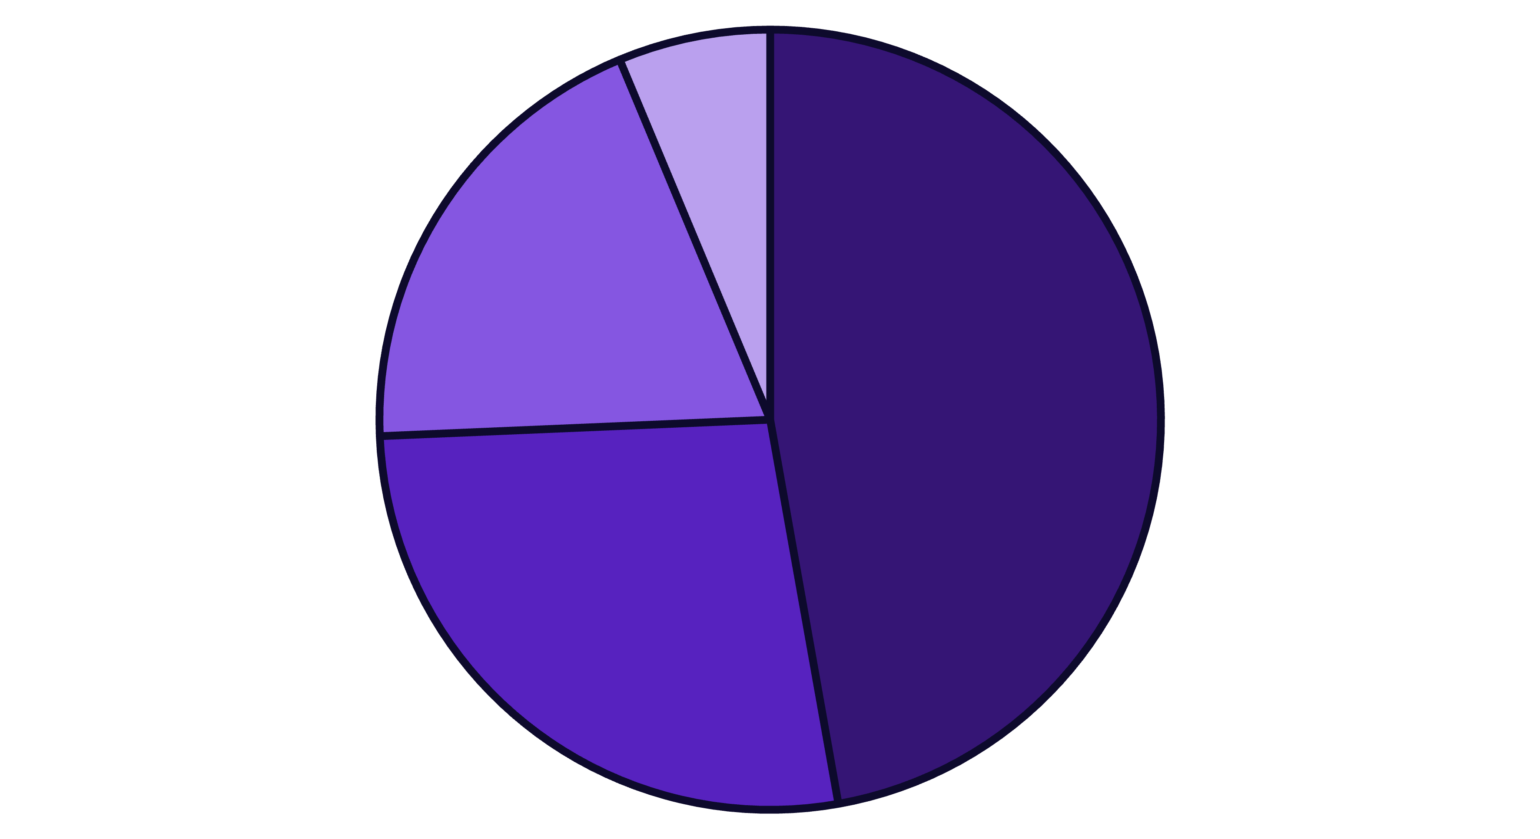
Reviews by Rating Category – Pie Chart
Good (4.0–4.49)
Excellent (4.5+)
Average (3.5–3.99)
Low (<3.5)
Over 50% of the courses fall under Good or Excellent categories.

Slide 7
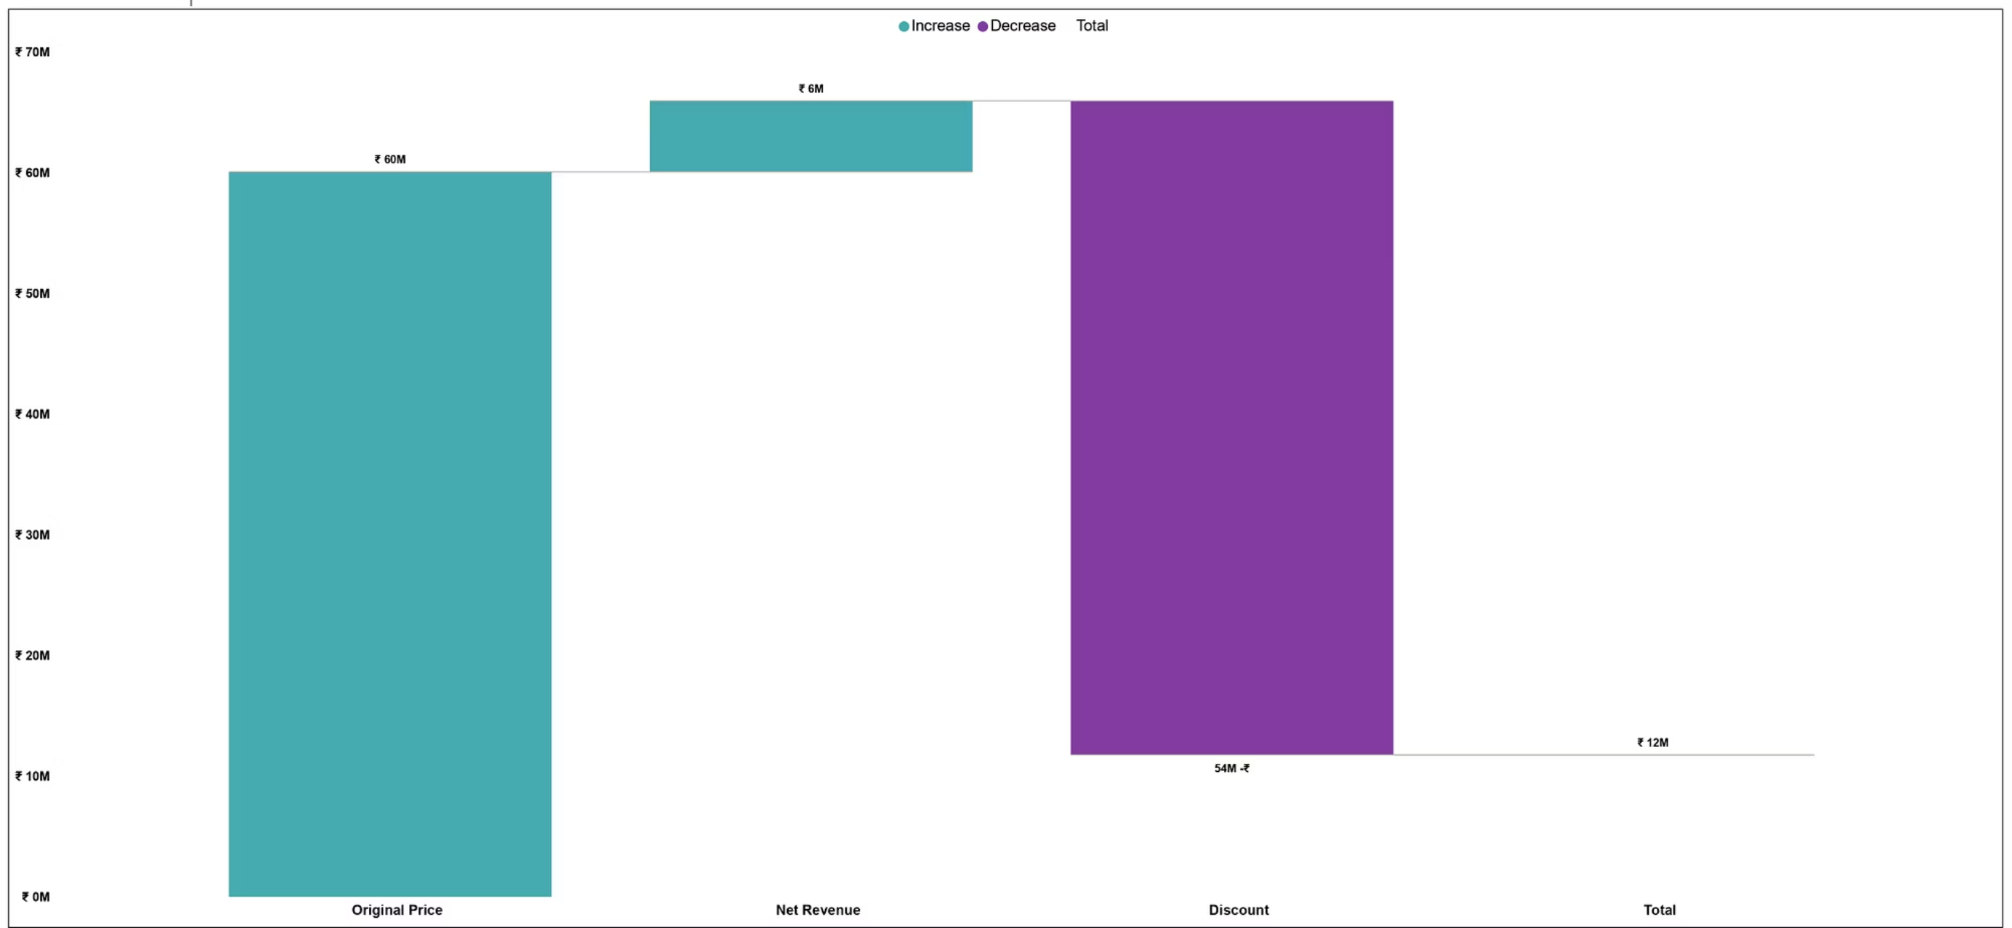
Waterfall Chart – Price to Net Revenue
Discounts brought the revenue down significantly.

Slide 8
Top Courses Comparison – Table
Course Title
Subscribers
Discount %
Rating
Price
MBA in 1 Course
374,836
94.73
4.47
₹8,640
SQL Bootcamp
295,509
94.73
4.67
₹8,640
Stock Market
259,894
64.45
9.35
₹1,280
Financial Analyst 2020
245,860
94.73
4.53
₹8,640
Deep Learning (V2+)
239,309
64.45
4.54
₹1,280
Tableau A–Z
209,070
94.73
4.60
₹8,640
Analyst & Investing
182,002
94.73
4.49
₹8,640

Slide 9
Thank You
This concludes our analysis of Udemy's Finance & Accounting courses. Dashboard insights reveal price sensitivity, user engagement, and content trends across a decade.

